Slide 1
PRODUCT RATING PROJECT

Slide 2
Problem Statement
Depending on customers reviews we have to predict the rating that they could have given to that product. It is a NLP problem. So here we are working on this project in 2 phases:
Data Collection: I collected reviews and rating data from amazon and flipkart for mobile, laptops and smart watches.
Analysing the data and building the model.

Slide 3
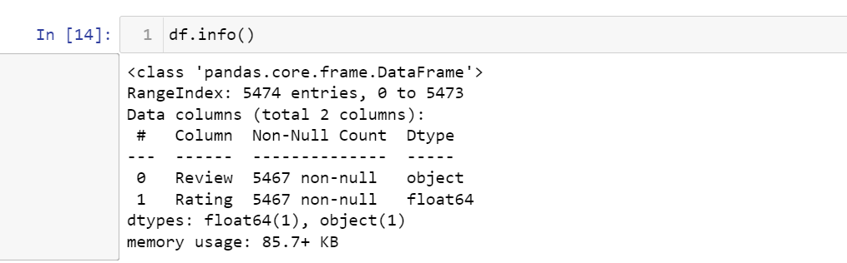
Exploratory Data Analysis
Shape of the data:
Null values present:
The dataset has no null values.
Data set is collected reviews and rating data from amazon and flipkart for
mobile, laptops and smart watches.

Slide 4
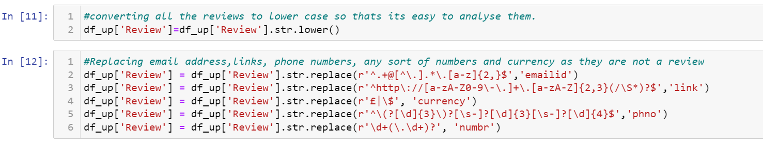
Feature Engineering-We have to fetch comment words from the reviews so in order to do
that we first converted entire reviews feature to lower case then replaced all the
phone numbers, email ids, URL’s, any sort of number and currency by
phno,emailed,link,numbr and currency respectively.

Slide 5
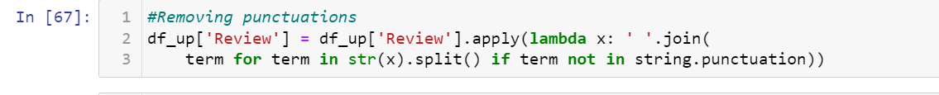
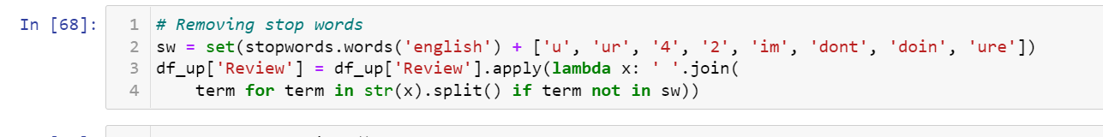
Further we removed all kinds of punctuations from the feature Review.
In order to fetch just the abusive words we also have to remove all kind of stop words.

Slide 6
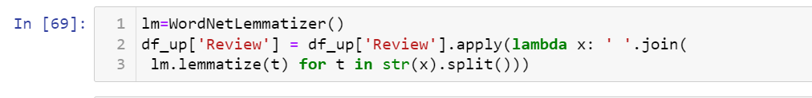
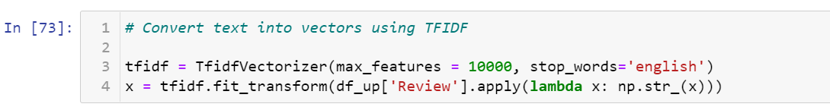
In order to further analyse the Review using morphological analysis of the words called
lemmatization.
Then finally we converted the Review into its vector form Term Frequency and Inverse
Document Frequency method

Slide 7
We split the data into training set and testing set using train test split method.
On this train and test data we applied various models: logistic regression, decision tree classifier, random forest classifier , Knn classifier.
The best performing model is random forest as it has least difference between cv score and test accuracy and recall, f1-score is the best among all. Since the model accuracy is very low so we performed hyperparameter tuning on it but there is no significant change in accuracy.
So, we saved our previous random forest classifier model

Slide 8
Hardware and Software Requirements and Tools Used
We imported following packages:
import pandas as pd
import numpy as np
import matplotlib.pyplot as plt
import seaborn as sns
from sklearn.preprocessing import OrdinalEncoder
from sklearn.preprocessing import LabelEncoder
from statsmodels.stats.outliers_influence import variance_inflation_factor
from scipy.stats import zscore
from sklearn.model_selection import GridSearchCV
from sklearn.preprocessing import StandardScaler
from sklearn.preprocessing import power_transform
from sklearn.model_selection import train_test_split
from sklearn.model_selection import cross_val_score
from sklearn import metrics
from sklearn.metrics import roc_curve,auc,classification_report
from sklearn.feature_extraction.text import TfidfVectorizer
import warnings
warnings.filterwarnings('ignore')
from nltk.stem import WordNetLemmatizer
import nltk
from nltk.corpus import stopwords
import string
Further we downloaded stopwords and wordnet module as well.

Slide 9
Run and Evaluate selected models

Slide 10
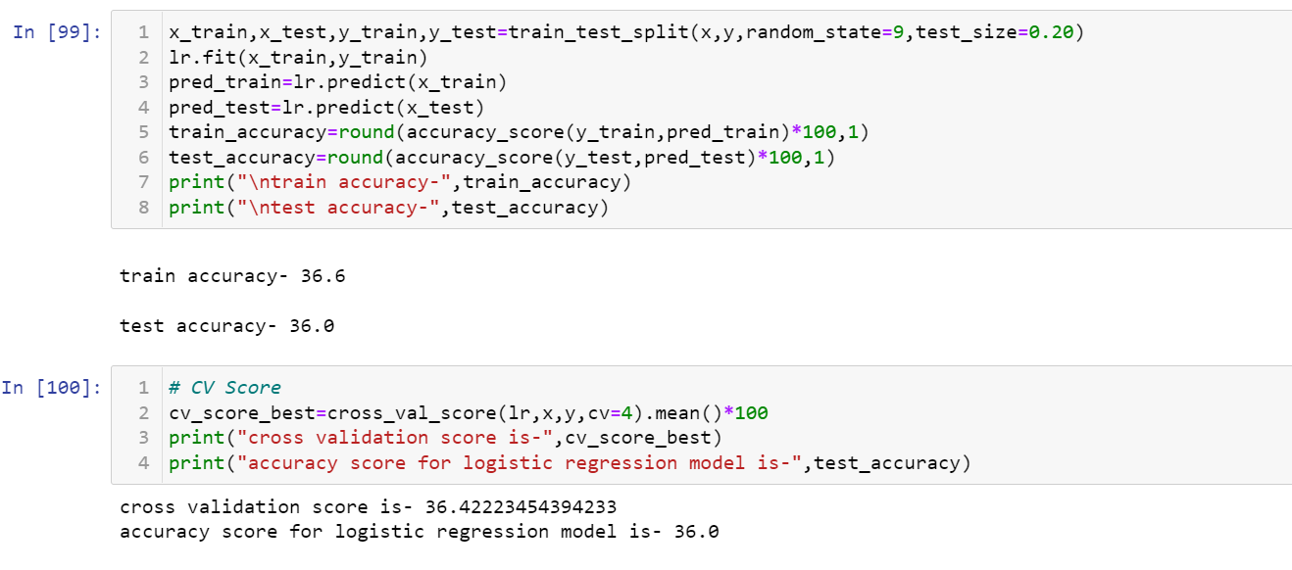
Logistic Regression
We applied this algorithm and found the train accuracy to be 36.6% and
test accuracy to be 36.0%.
The test accuracy for Logistic regressor regression is 36.0% and its cv score is 36.4% thus
making us sure that the model is not overfitted.

Slide 11
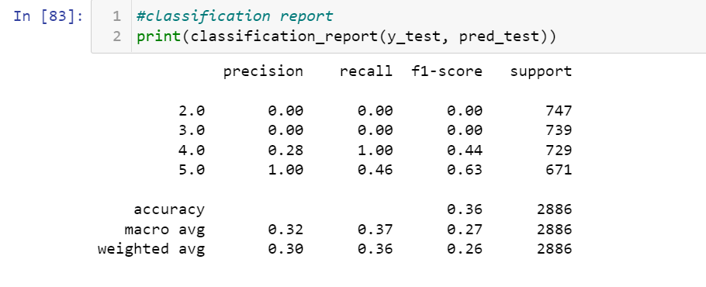
Classification Report

Slide 12
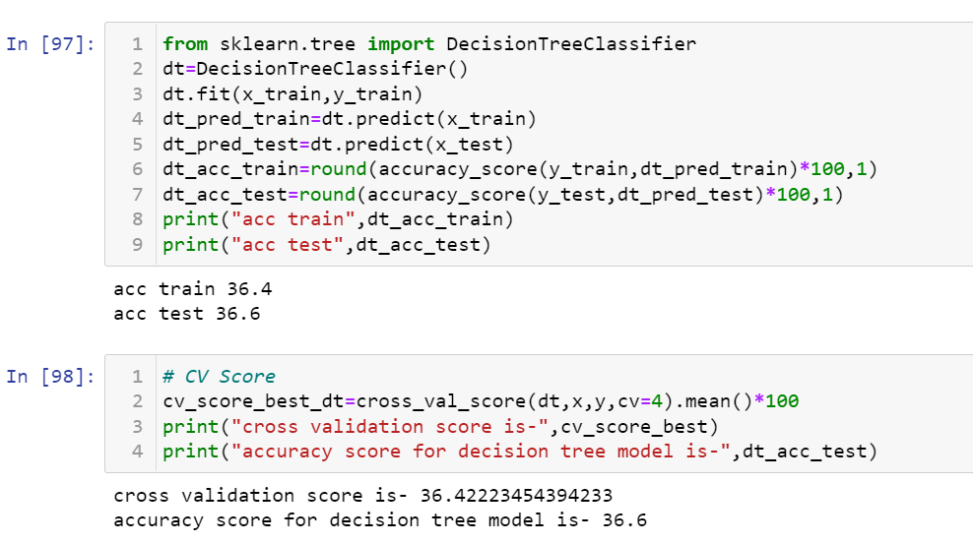
Decision Tree Classifier
We applied this algorithm and found the train accuracy to be 36.4% and test
accuracy to be 36.6%.
The test accuracy for decision tree regression is36.6% and its cv score is 36.4% thus
making us sure that the model is not overfitted, although decision tree regressor is prone to overfitting.

Slide 13
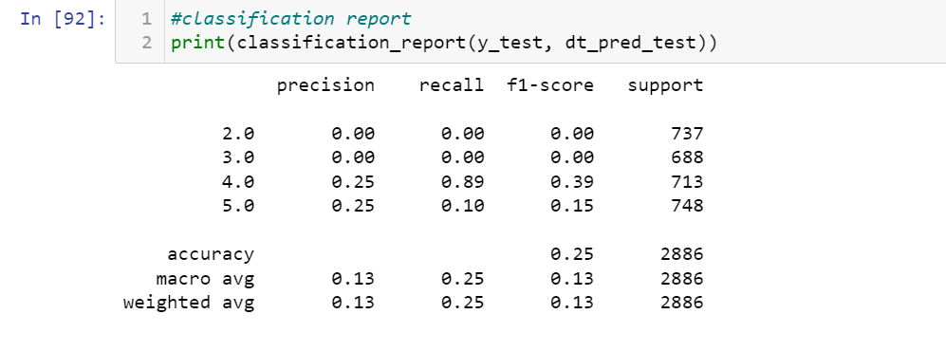
Classification Report:

Slide 14
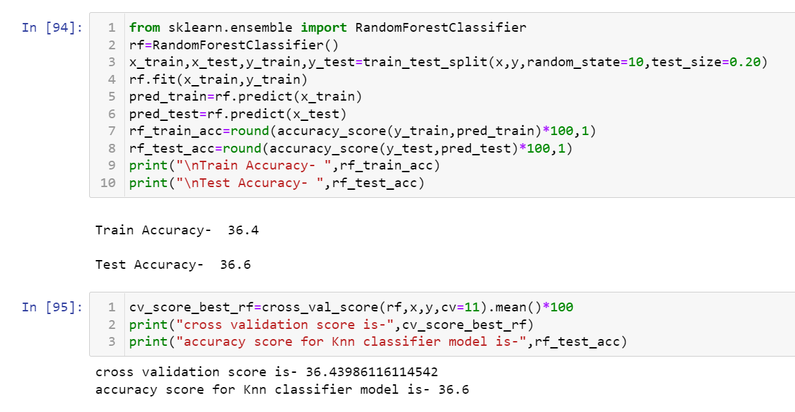
Random Forest Classifier
We applied this algorithm and found the train accuracy to be 36.4% and test
accuracy to be 36.6%.
The test accuracy for random forest classifier is 36.4% and its cv score is 36.6%
thus making us sure that the model is not overfitted.

Slide 15
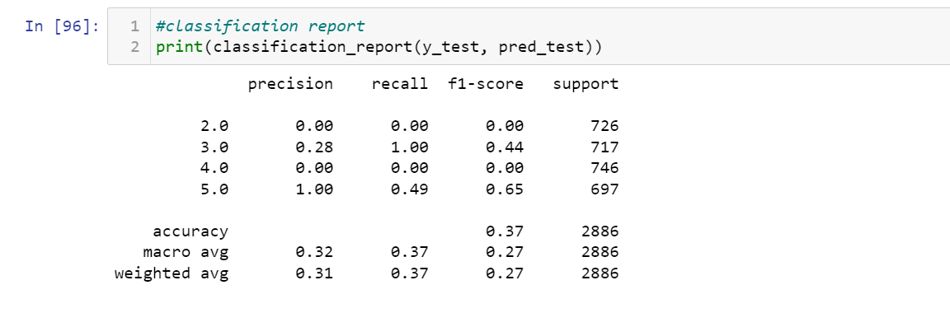
Classification Report:

Slide 16
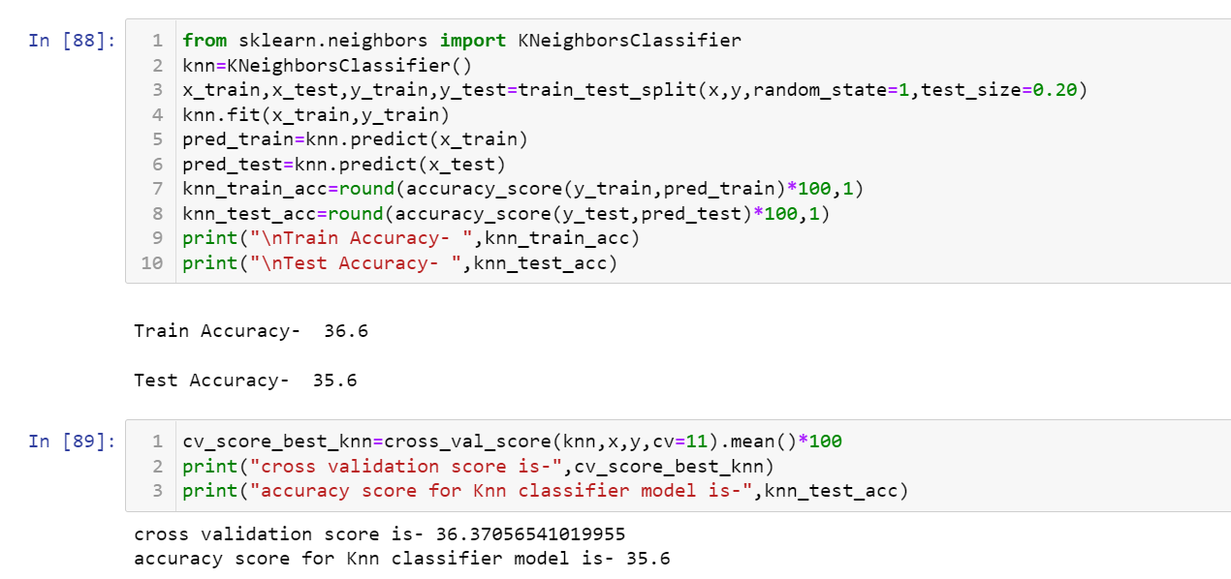
Knn Classifier
We applied this algorithm and found the train accuracy to be 36.6% and test accuracy
to be 35.6%.
The test accuracy for Knn regression is 35.6% and its cv score is 36.3% thus making
us sure that the model is not overfitted.

Slide 17
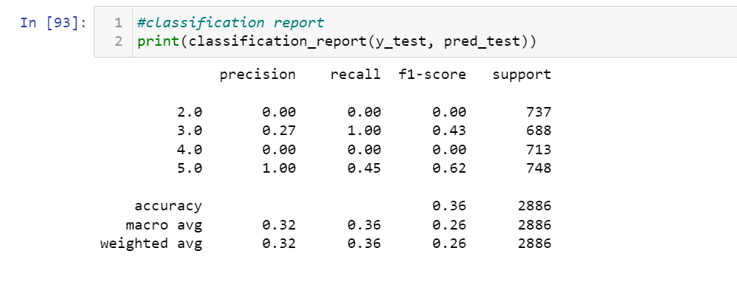
Classification Report:

